Slide 1
Robbery rate prediction using rnn-lstm
Simantini ghosh
Ubit – 50540673

Slide 2
What is Time Series Forecasting?
Time Series Forecasting: Predicting the Future
Time series forecasting is the art and science of analyzing past data points collected over time to predict future values. This powerful tool finds applications across various domains, enabling informed decision-making and strategic planning.
Here's why time series forecasting matters:
Unveiling Hidden Patterns: By examining historical data, we can identify trends, seasonality, and cyclicality, providing valuable insights into the underlying behavior of the data. This understanding is crucial for accurate predictions.
Informed Decision Making: Businesses can utilize forecasts to anticipate future demand, optimize inventory levels, allocate resources efficiently, and develop effective marketing strategies. Governments can utilize it for resource planning, infrastructure development, and disaster preparedness.
Risk Management: Forecasting helps assess potential risks and opportunities, allowing for proactive mitigation strategies and improved preparedness for unforeseen events. This is particularly relevant in finance, insurance, and supply chain management.
Financial Planning: Organizations can predict future revenue, expenses, and profitability through forecasting, leading to better budgeting, investment strategies, and resource allocation. This allows for greater financial stability and growth.
From predicting stock prices and weather patterns to understanding customer behavior and energy consumption, time series forecasting plays a pivotal role in navigating the uncertainties of the future. By leveraging the power of historical data, we gain valuable foresight to make informed decisions and shape a more successful future.

Slide 3
Challenges in Time Series Forecasting
While time series forecasting offers valuable insights, it comes with inherent challenges that can impact prediction accuracy. Understanding these challenges is crucial for choosing the right approach and interpreting the results effectively.
Key challenges include:
Non-stationarity: Many real-world time series exhibit non-stationarity, meaning their statistical properties like mean and variance change over time. This makes it difficult to apply traditional forecasting methods that assume stationarity.
Seasonality: Seasonal patterns, such as daily, weekly, or yearly fluctuations, can significantly influence the data. Accurately modeling and accounting for these seasonal variations is crucial for reliable forecasts.
Noise and Outliers: Realworld data often contains noise and outliers, which can distort the underlying patterns and lead to inaccurate predictions. Identifying and handling these anomalies is essential for improving forecasting accuracy.
Long-term Dependencies: Some time series exhibit long-term dependencies, where past events influence future values over extended periods. Capturing these complex relationships can be challenging for traditional models.
Choosing the Right Model: With a plethora of forecasting methods available, selecting the most appropriate model depends on the specific characteristics of the data and the forecasting goals. This requires careful consideration and expertise.
By acknowledging these challenges and employing appropriate techniques, we can improve the accuracy and reliability of time series forecasts, unlocking their full potential for informed decision-making.

Slide 4
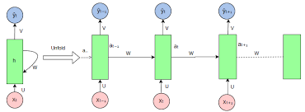
Introduction to RNNs (Recurrent neural network)

Slide 5
Introduction to RNNs (Recurrent neural network)
Recurrent Neural Networks (RNNs) process sequential data by utilizing recurrent connections.
Basic architecture includes input, output, and hidden state vectors.
At each time step, RNNs take an input vector, update the hidden state based on the current input and previous hidden state, and produce an output vector.
RNNs can handle sequences of variable lengths due to their recursive nature.
Traditional RNNs suffer from the vanishing gradient problem, limiting their ability to capture long-term dependencies.
Variants like Long Short-Term Memory (LSTM) and Gated Recurrent Unit (GRU) address this issue with specialized memory cells.
LSTM and GRU cells better retain and utilize information over long sequences.
RNNs are valuable in tasks such as natural language processing, time series prediction, and speech recognition due to their ability to model and understand complex sequential data.

Slide 6
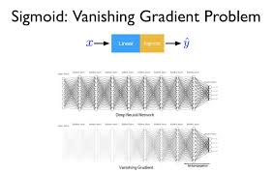
vanishing/exploding gradient problem
Vanishing Gradient Problem: In deep networks, gradients can become extremely small during backpropagation, especially in networks with many layers. This results in slow or halted learning for early layers, impeding the model's ability to capture long-term dependencies.

Slide 7
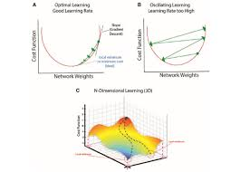
vanishing/exploding gradient problem
Exploding Gradient Problem: Conversely, in some cases, gradients can become extremely large during backpropagation, causing weight updates to become disproportionately large and destabilizing the training process.

Slide 8
Long Short-Term Memory (LSTM) Networks
Long Short-Term Memory (LSTM) networks are a specialized type of recurrent neural network (RNN) designed to address the vanishing gradient problem encountered in traditional RNNs. LSTMs introduce a more sophisticated memory cell architecture that allows them to retain information over long sequences and mitigate the vanishing gradient issue. Here's how LSTMs overcome the problem:
Memory Cells: LSTMs contain memory cells with self-connected recurrent connections. These cells maintain a constant error flow, preventing the vanishing gradient problem by allowing gradients to flow through unchanged over many time steps.
Gating Mechanisms: LSTMs incorporate gating mechanisms, including input, forget, and output gates. These gates regulate the flow of information within the cell, enabling LSTMs to selectively retain or discard information over time. By controlling the flow of gradients through these gates, LSTMs effectively address the vanishing gradient problem.
Long-Term Dependencies: With their ability to retain information over long sequences, LSTMs excel at capturing and preserving long-term dependencies in sequential data, making them well-suited for tasks such as natural language processing, speech recognition, and time series prediction.
By utilizing memory cells and gating mechanisms, LSTMs provide a robust solution to the vanishing gradient problem, enabling more effective training and better modeling of sequential data.

Slide 9
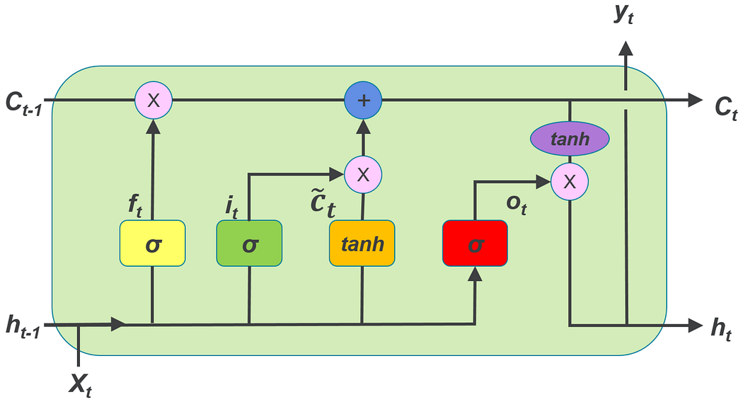
Long Short-Term Memory (LSTM) Networks

Slide 10
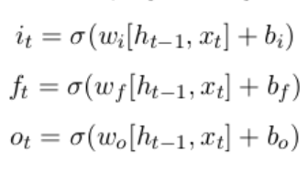
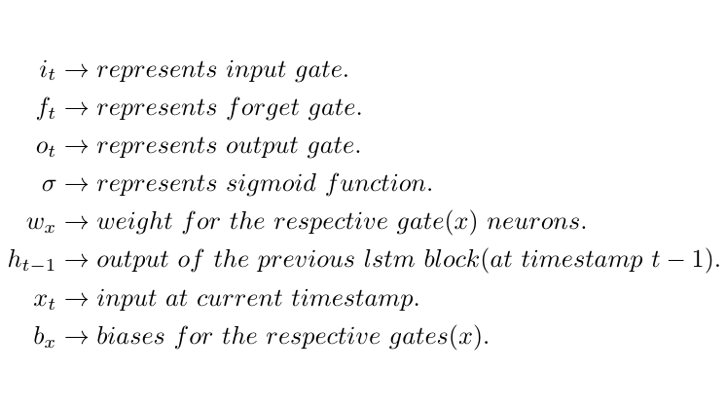
Long Short-Term Memory (LSTM) Networks
we use sigmoid function for gates because, we want a gate to give only positive values and should be able to give us a clear cut answer whether, we need to keep a particular feature or we need to discard that feature.
“0” means the gates are blocking everything.
“1” means gates are allowing everything to pass through it.
The equations for the gates in LSTM are:

Slide 11
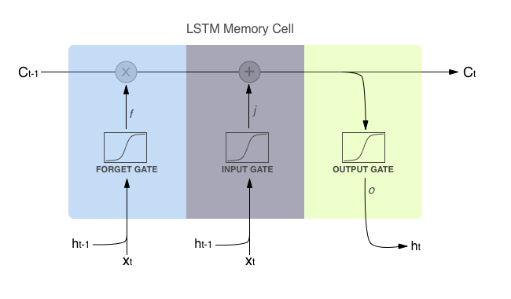
Long Short-Term Memory (LSTM) Networks
First equation is for Input Gate which tells us that what new information we’re going to store in the cell state(that we will see below).
Second is for the forget gate which tells the information to throw away from the cell state.
Third one is for the output gate which is used to provide the activation to the final output of the lstm block at timestamp ‘t’.

Slide 12
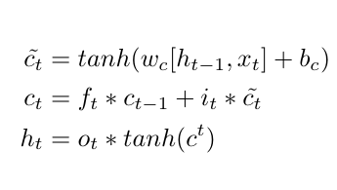
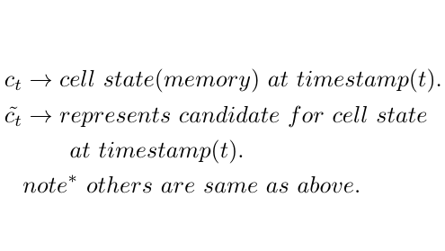
Long Short-Term Memory (LSTM) Networks
The equations for the cell state, candidate cell state and the final output:

Slide 13
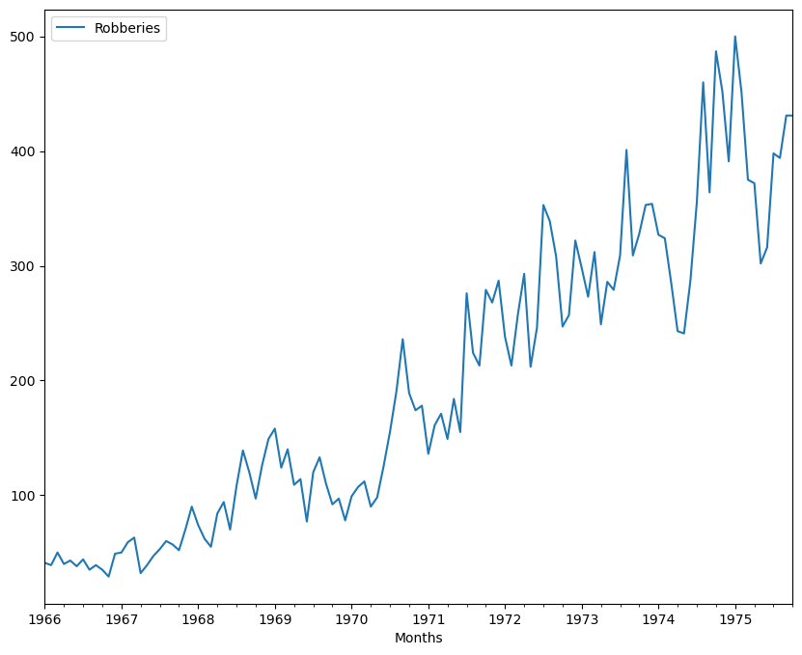
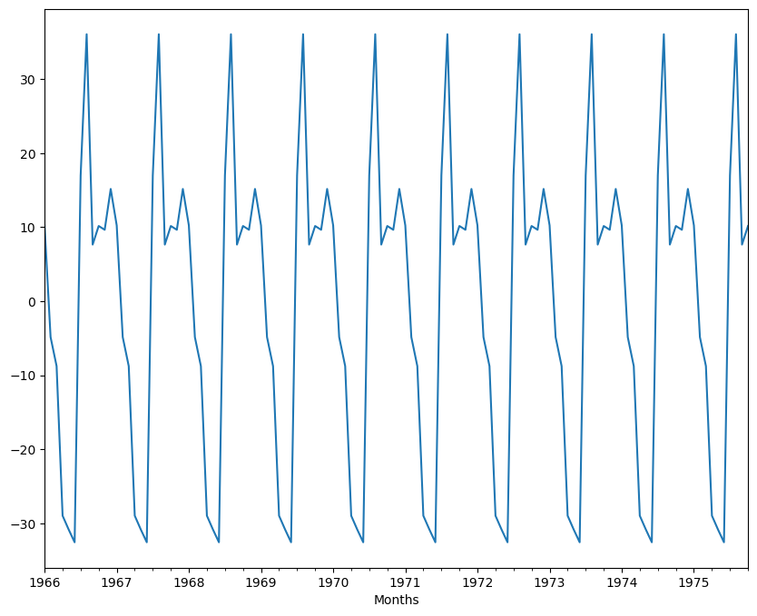
Data Description
For our model we have selected the Monthly Robbery Rate from Fred, which has a frequency of month start. Through seasonal decompose using the statsmodels library we can visualize that the data has shown upwards trend and a seasonality of 12 months.
Trends Seasonality

Slide 14
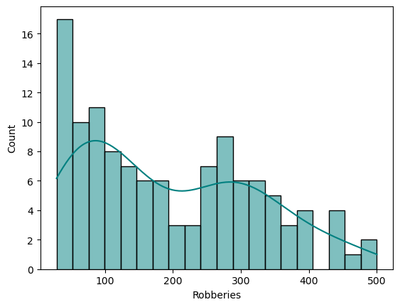
Data Description
We have also plotted a histogram to check the distribution of robbery rate.

Slide 15
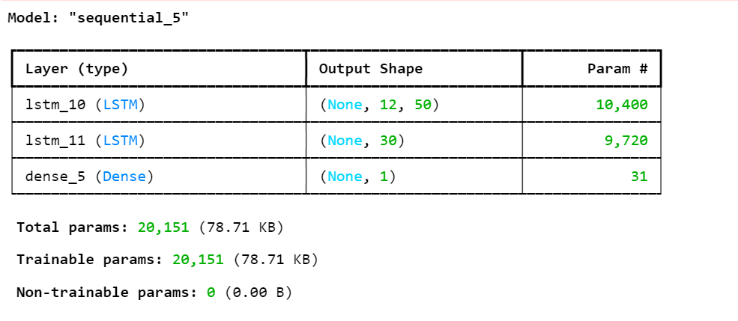
Model Architecture
We have used LSTM RNN model with
1 input layer with 50 neurons and ReLu as activation function.
1 hidden layer with 30 neurons and ReLu as activation function.
Output dense layer with 1 neuron.
As optimizer we have used “adam” and “mse” as loss function criteria.
The model is trained with 200 epochs.

Slide 16
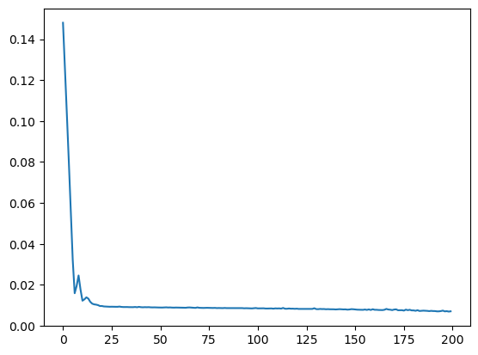
Training Process
We have splitted the entire data in 106 training data and 12 test data.
We have applied feature scaling on the training data in order to our model to interpret these features on the same scale.
We have preprocessed our training data to generate a sequence where past 12 months data would help to predict the next data as we have got a seasonality.
We have fit our training data into our sequential model and trained the model for 200 epochs, with adam as optimizer and mse as loss criterion.
The training loss per epoch is as below

Slide 17

Evaluation Metrics
For our model evaluation as it’s a continuous output we have used RMSE(root mean squared error) as our evaluation metrics, we have used the rmse function from statsmodels library to calculate the rmse score on our test data.
We have achieved a rmse of 72.73 with our model.

Slide 18
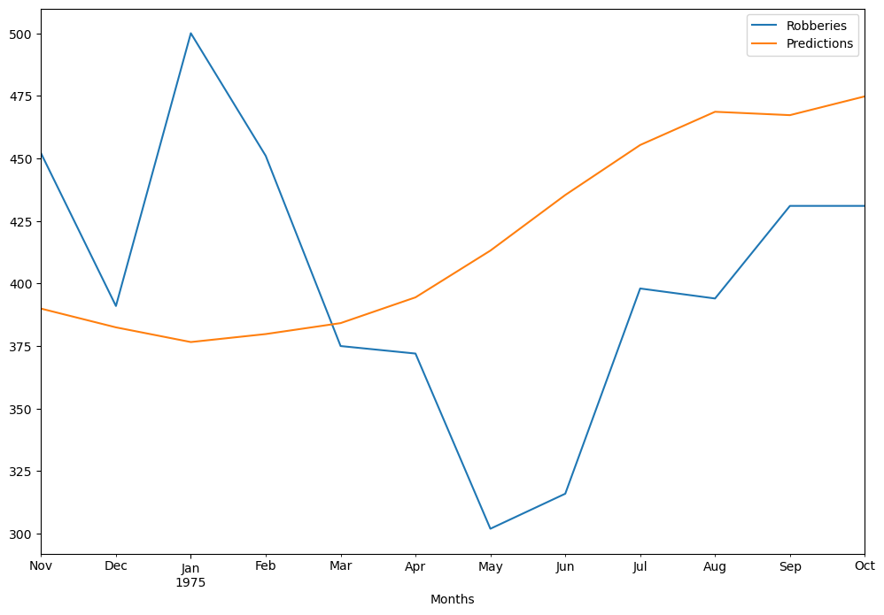
Results
We have plotted our prediction with respect to actual data.

Slide 19
Model analysis
Pros of using RNN/LSTM models for time series prediction:
Ability to Capture Temporal Dependencies: RNNs and LSTMs are well-suited for time series prediction tasks because they can capture temporal dependencies within the data, allowing them to learn patterns and trends over time.
Flexibility in Handling Sequential Data: RNNs and LSTMs can handle sequences of variable lengths, making them adaptable to various time series data formats without the need for fixed-size input.
Effective for Long-Term Dependencies: LSTMs, in particular, excel at capturing long-term dependencies, which is crucial for forecasting tasks where historical information from distant time steps is relevant.
Implicit Feature Extraction: RNNs and LSTMs automatically extract features from sequential data, reducing the need for manual feature engineering, especially in tasks where the underlying patterns may be complex or not fully understood.
Cons of using RNN/LSTM models for time series prediction:
Training Complexity: Training RNNs and LSTMs can be computationally intensive, especially with large datasets and complex architectures, which may require significant computational resources and time.
Susceptibility to Overfitting: RNNs and LSTMs are prone to overfitting, especially when the model capacity is high relative to the size of the training data. Regularization techniques and careful model selection are necessary to mitigate this risk.
Difficulty in Capturing Short-Term Patterns: While LSTMs excel at capturing long-term dependencies, they may struggle with capturing short-term patterns in the data, especially if the time series exhibits rapid fluctuations or noise.
Challenges with Sequential Data Preprocessing: Preprocessing sequential data for RNNs and LSTMs can be challenging, particularly when dealing with missing values, irregular time intervals, or non-stationary data. Careful preprocessing steps are necessary to ensure the effectiveness of the model.

Slide 20
Conclusion
LSTM and RNN models offer powerful tools for time series analysis, allowing us to capture complex temporal dependencies and make accurate predictions.
These models excel in handling sequential data, offering flexibility in processing data of varying lengths and capturing long-term dependencies.
However, challenges such as training complexity, susceptibility to overfitting, and difficulty in capturing short-term patterns must be carefully addressed.
Despite these challenges, LSTM/RNN models remain valuable assets in the field of time series analysis, offering a promising avenue for extracting insights and making informed decisions in various domains.

Slide 21
References
https://fred.stlouisfed.org/
https://medium.com/@divyanshu132/lstm-and-its-equations-5ee9246d04af
https://en.wikipedia.org/wiki/Recurrent_neural_network
https://towardsdatascience.com/

Slide 22
THANK YOU

